Slide 1

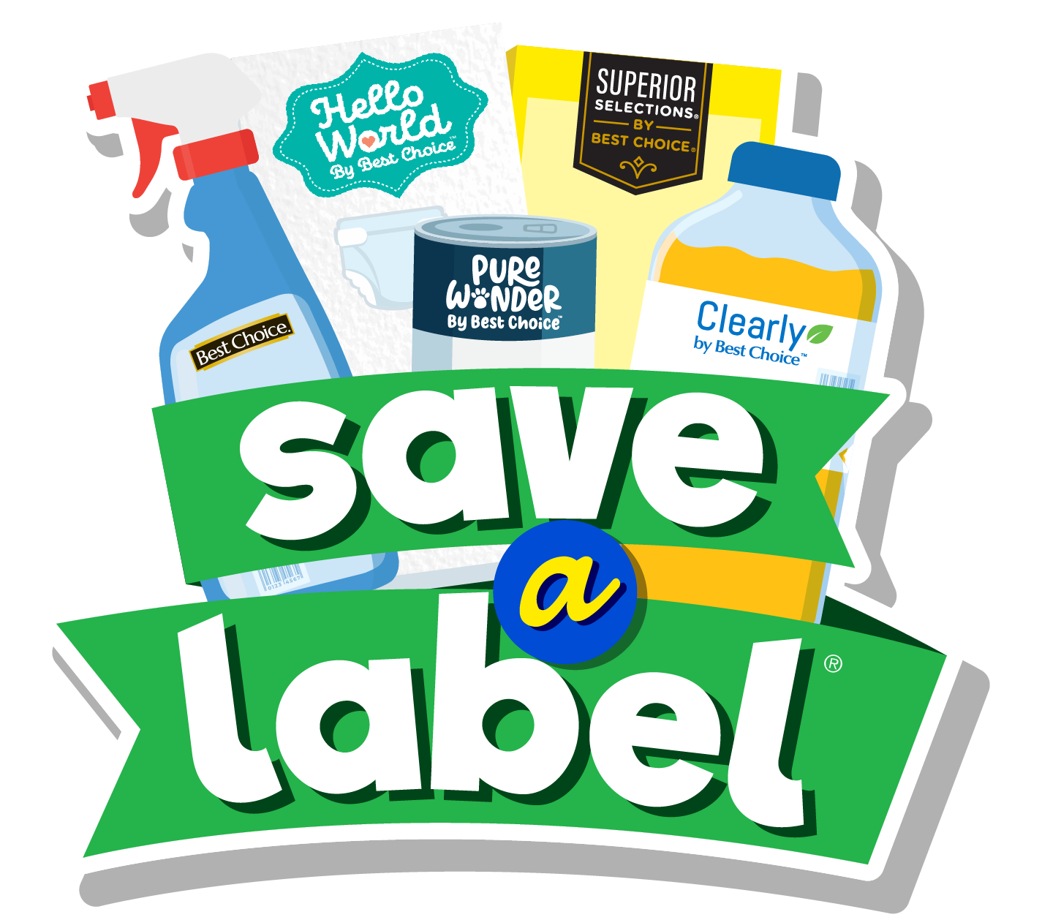
AWG Save a label group presentation
04/29/2025

Slide 2
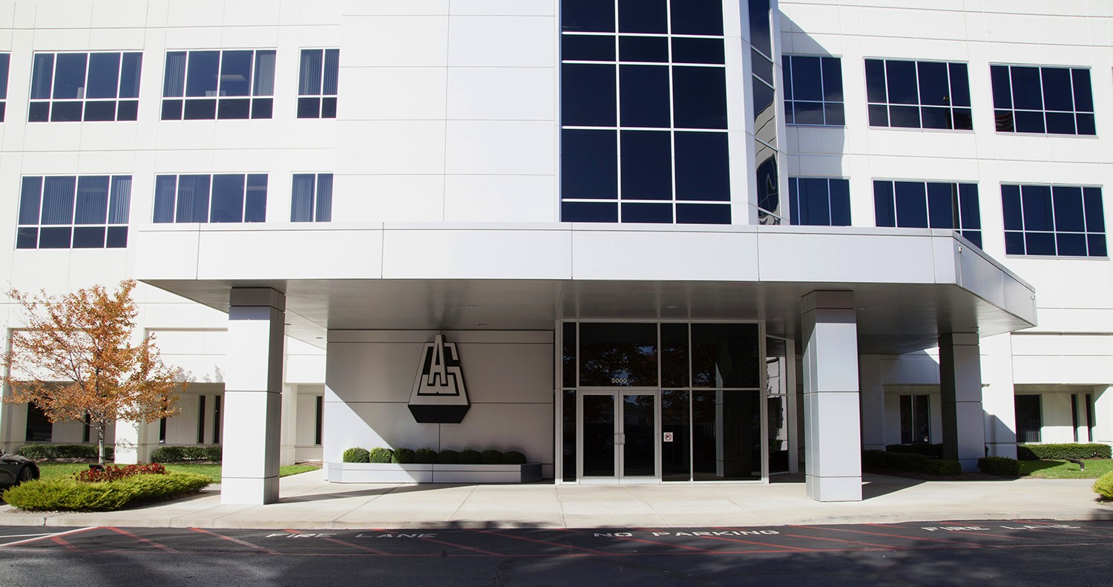

Agenda
01 Introduction
02 Technical approach
03 Dashboard demo
04 Our Suggestions
05 Conclusions
06 Q&A

Slide 3
01 Introduction

Slide 4

Company Overview
Associated Wholesale Grocers (AWG)
Largest cooperative food wholesaler in the US.
Serve over 3,400 retail locations.
Over 31 states.
9 distribution centers.
In 2023, consolidating sales amounted
to $12.4 billion.

Slide 5
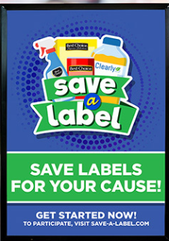
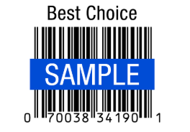
Save a Label Program
A charity program where customers can donate food labels to non-profit organizations and to help them raise funds.
How does it work?
Non-profit organizations collect 1,000 best choice labels and can get $30 from AWG.
Goal
Helping retailers build good relationships with the community.
Participants
8900+ organizations ( $1million+)

Slide 6
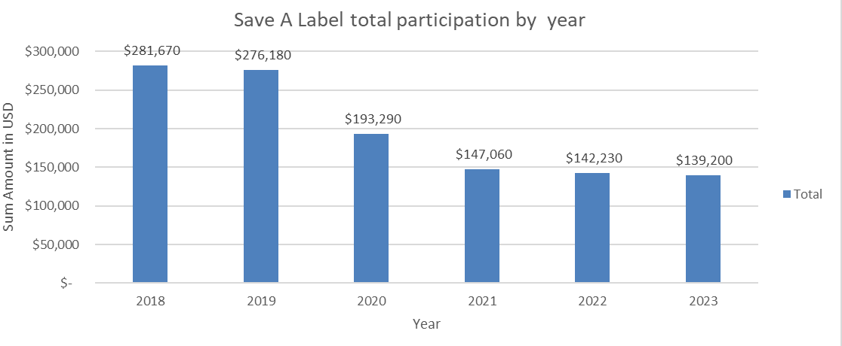
Problem Overview
Client Problem:
Participation in the Save-A-Label Program has been declining for the last four years.
As we can see from the graph, the overall participation has decreased by a total of 142.470$ from 2018 to 2023 (-50%).

Slide 7
2024 Fall Semester Conclusions
Overall participation has decreased by a total of $142,470 from 2018 to 2023 (-50%).
The overall participation has declined in all the states where the program takes place.
The majority of the total amount is related to nonprofits associated with religious organizations.
This decrease is likely due to 2 main factors:
Covid-19 pandemic
Change in engagement with the nonprofits (reduced promoting activities from AWG)

Slide 8
2025 Spring Solution
Save A Label dashboard website
-> No code solution for Save A Label program daily operation
-> YoY historical data analysis
Non-profit participation Predictive machine learning model
-> Budget prediction
-> Potential marketing promotion
Digitalize APP suggestion

Slide 9
02 Technical Approach

Slide 10




Data transformation and refining
01
02
03
04
ARIMA - Machine Learning
Python - clean data
Streamlit Cloud
Inner AI technique
Processing the raw data.
Gathering all files and group by different customers to different category.
Transfer time columns
Develop a user-friendly online dashboard tailored for our clients, ensuring seamless accessibility.
To prevent data leakage, we've integrated a locally hosted AI system into our dashboard, utilizing Ollama combined with Retrieval-Augmented Generation (RAG) techniques.
Apply the ARIMA (AutoRegressive Integrated Moving Average) model to forecast future values in time series data by capturing temporal patterns and trends.

Slide 11
03 Dashboard Demo

Slide 12
Dashboard Overview
SaveALabel_DB
This dashboard was developed to support the AWG Save-A-Label team with a dynamic tool to track key performance indicators of the program.
It highlights important metrics, including total payouts to nonprofits, the number of participating nonprofits categorized by activity, and the geographical distribution of program activity across U.S. states.
With its user-friendly and interactive interface, users can apply filters to explore the data and gain better insight into program reach, engagement, and impact

Slide 13
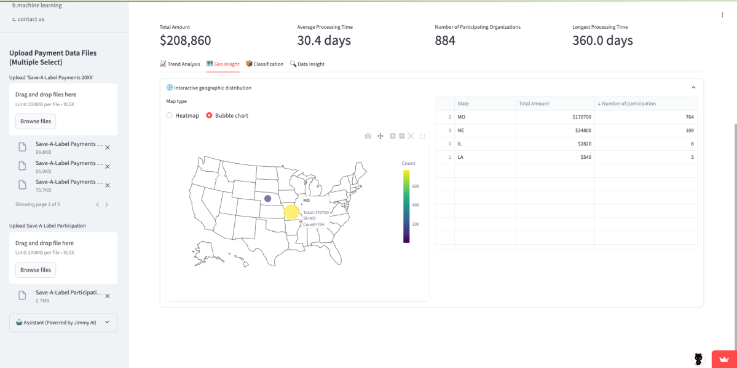
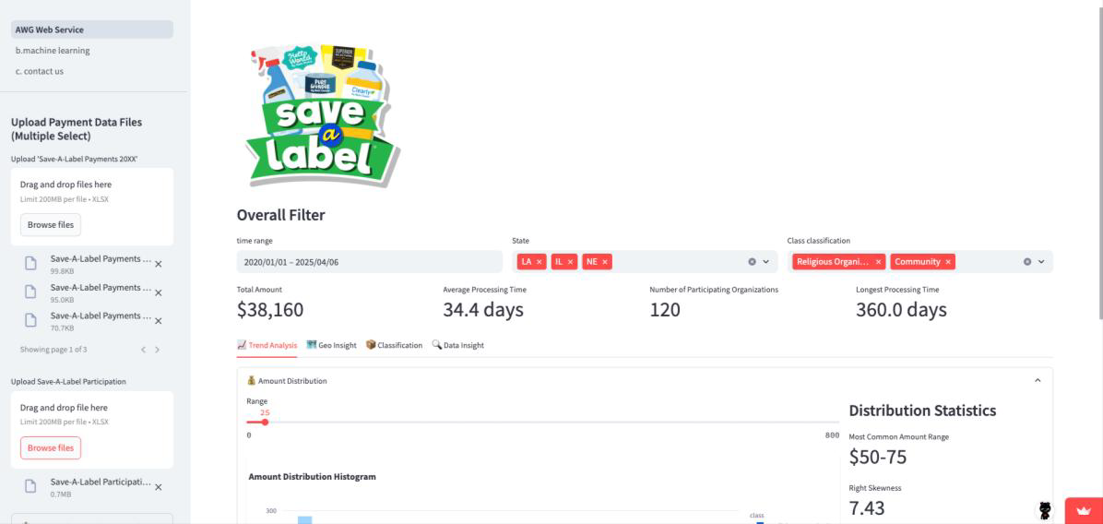
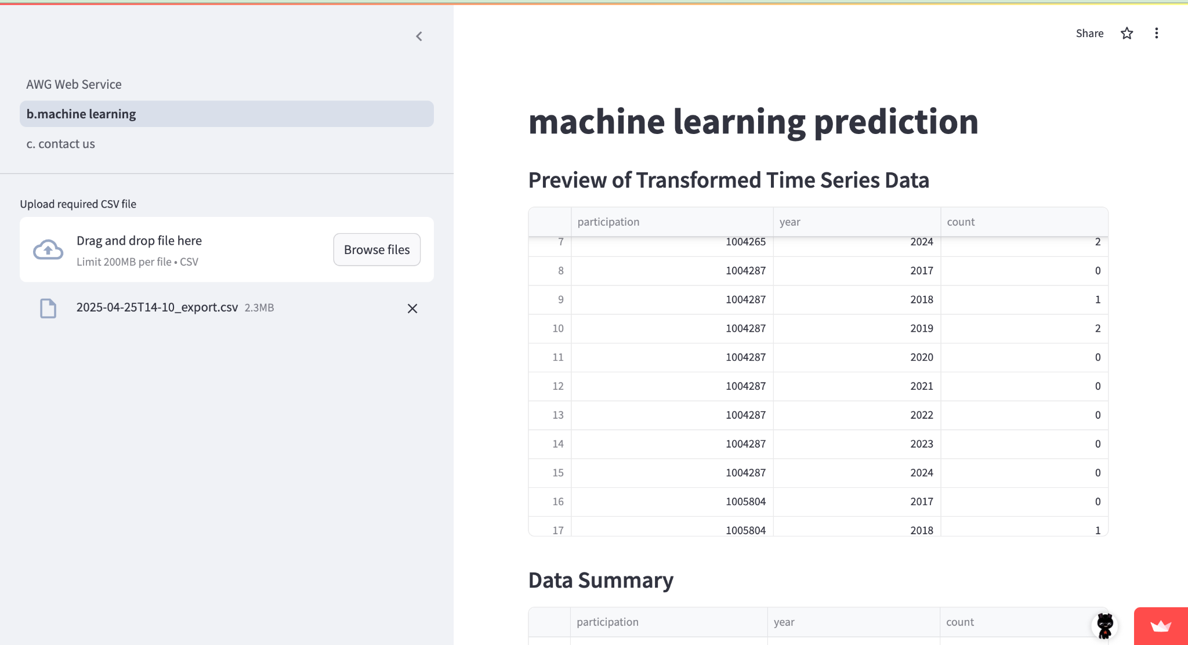
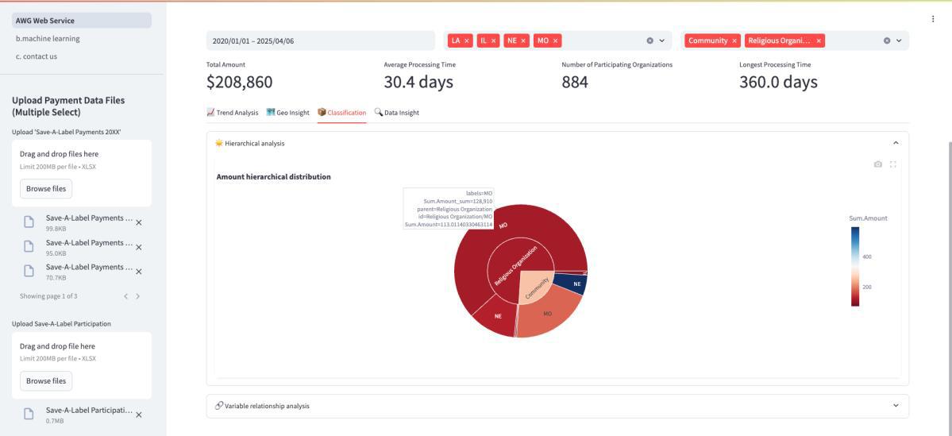
Dashboard Demo

Slide 14
Scenario 1
SaveALabel_DB
The client thought that "food banks" are a popular type of charitable organization. They are interested in understanding how many food bank organizations are located near their headquarters in Kansas and Missouri (KS/MO). Additionally, they want to analyze how much they have contributed to Save A Label programs. (Trend Analysis)
They want to further compare food bank to educational organization (Classification)

Slide 15
Scenario 2
SaveALabel_DB
The client plans to launch a promotional campaign targeting the Mid-America region (Missouri, Kansas, Nebraska, Oklahoma, and Arkansas). (MO, KS, NE, OK, AR) They are particularly interested in food bank organizations, a popular type of charity. They want to understand: (Geo Insight)
How many food banks are located near their headquarters (Kansas/Missouri)?
Their historical contribution amounts to food bank programs in this region.
They finally want to download these organizations’ information. (Data Insight)

Slide 16
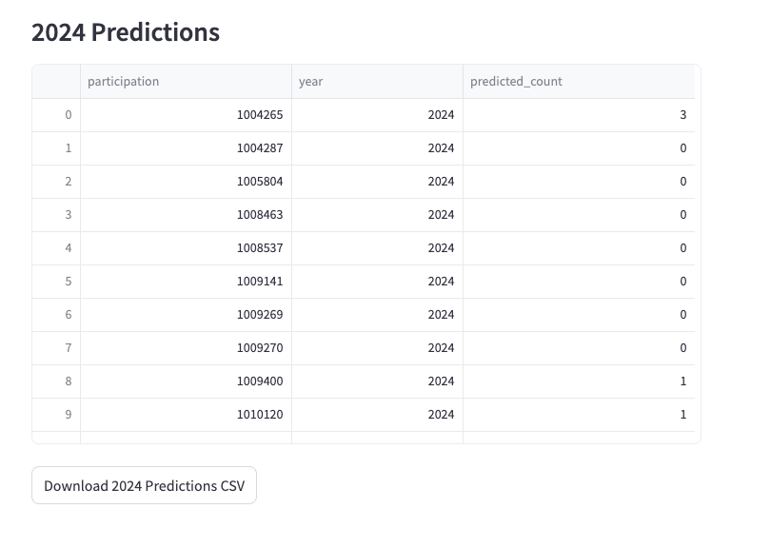
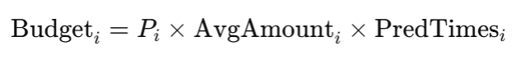
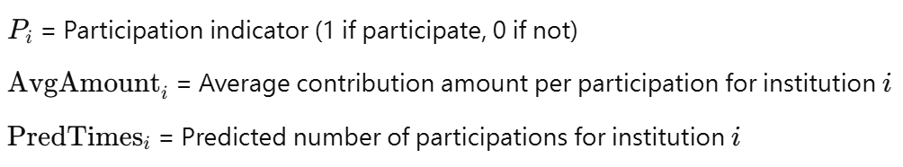
Scenario 3
SaveALabel_DB
The client is worried about planning Save A Label's budget for next year.
To support better decision-making, we propose implementing a machine learning solution that leverages historical contribution and project data to predict and optimize the next year's budget.
Our model successfully predicts 70% accuracy of each organization's participation.
Budget Formula:

Slide 17
04 Our Suggestions

Slide 18
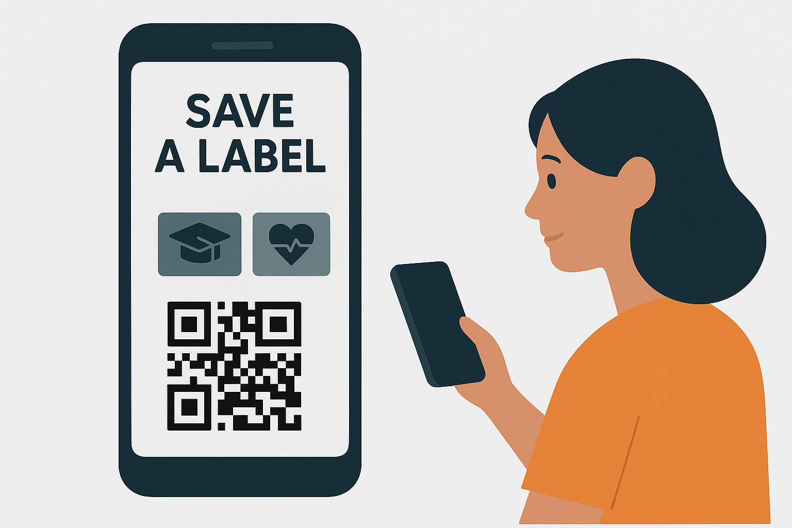
Our Idea Save a Label App
Our idea is based on a mobile app where both AWG's customers and nonprofits can register.
Customers can browse and select nonprofits organizations by category (e.g., education, health, environment).
Each eligible product features a QR code.
After purchase, customers scan it and assign it to a nonprofit via the app.
Everything is digital, simple, and instant.

Slide 19
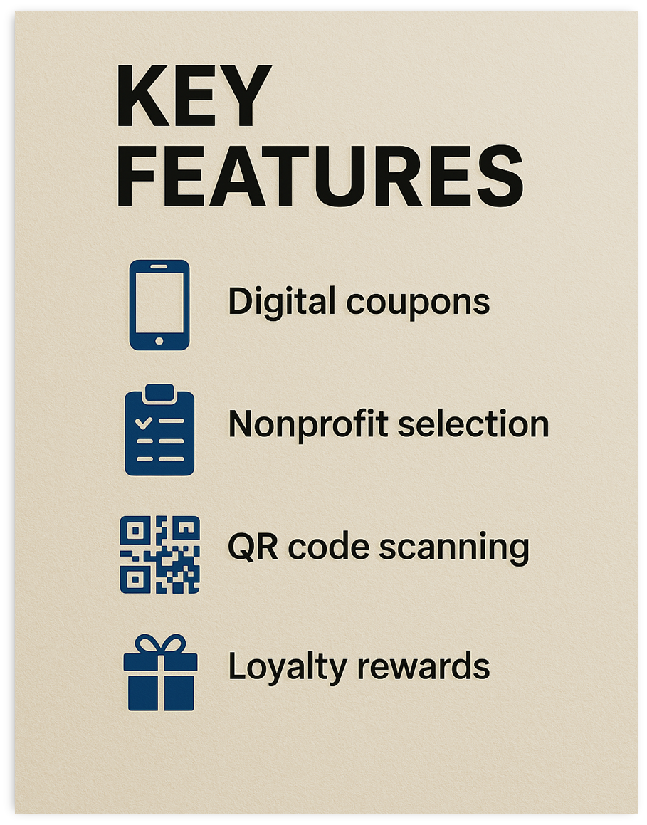
App Key Features
Customers
•Scan QR codes to donate labels
•Browse nonprofits by cause or location
•Track all the donations
•Set favorite nonprofits
•Earn rewards after milestones (e.g., mug, tote bag, headphones)
AWG
•Register and manage profiles
•View real-time label contributions

Slide 20
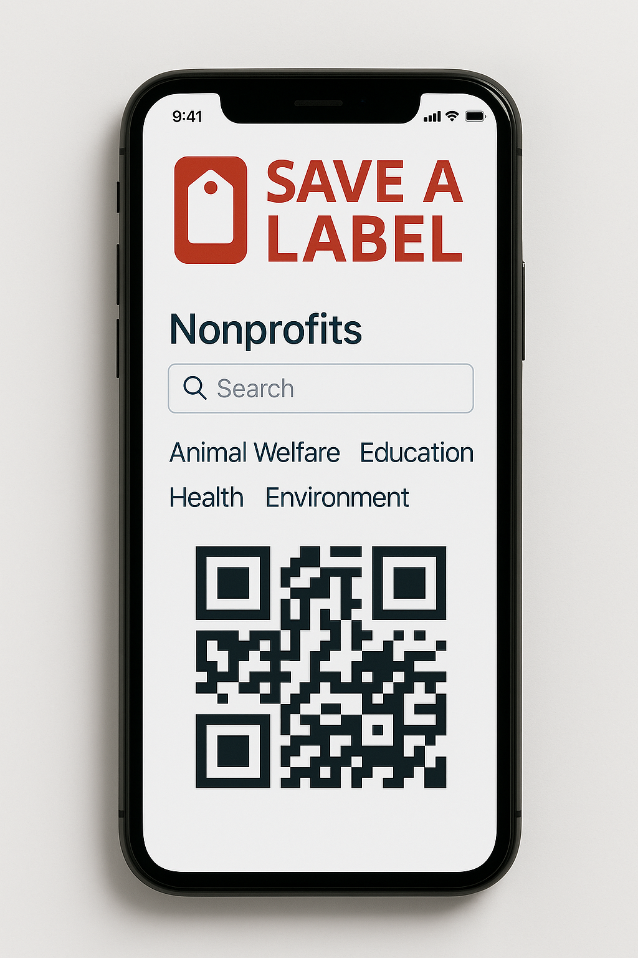
Advantages of the Save a Label App
This app could represent a “win-win” for both customers and AWG for the following reasons:
This app empowers customers, supports nonprofits, and drives value for AWG.
With a simple scan, users can easily send the labels to their favorite nonprofits.
AWG can strengthen its community ties and gains actionable insights on customer preferences.

Slide 21
05 Conclusions

Slide 22
What have we done?
Our team provided insights into past trends of the AWG Save a Label program. Enabling the AWG team to gain an in-depth understanding of the overall data.
We created an interactive Dashboard allowing AWG to have a clear understanding of their data with visualizations.
We developed a machine learning model to forecast future participation to help with the budgeting process.
Our suggestions to promote the program
Based on our findings, we suggested new ways to promote and increase the engagement in the program: Creating an app to engage customers in the program.

Slide 23
06 Q&A

Slide 24

Thank you

